Slide 1
1-1 Merge and 1-Many Merge
PrintNet T

Slide 2
Context Schema
Workflow
Data Input
&
Manipulation
Document
Design
(Layout)
Impositioning
Approval (Proof)
Spool Production
Notes:
Data mergers are part of the Data Processing function of the workflow.

Slide 3

Merging Data – Introduction
Merging data brings two separate data files together into one collection of data.
Two important data mergers are:
  1-1 Merge
  1-Many Merge
  The order in which data files are merged does matter.
Notes:
Merging data brings two separate data files together into one collection of data.
You need a variable in common in both data files.
Based on the common variable, you can merge the data in one of two ways:
1-1 Merge – Include the information in the second data file in the original array from the first data file.
1-Many Merge – Create a sub-array of data from the second data file inside of the array from the first data file.
The order of your data files does matter!

Slide 4

Merging Data – Purpose
Related data are sometimes saved on separate files.
  Because of privacy policies
  To save space on a database
Data merging makes it possible to bring the related data together later.
Notes:
Data files are created separately so as not to have redundancies. Transactions files are created periodically (monthly, quarterly, etc.); personal client information is only needed once – it doesn’t change. However, on most jobs involving periodical and fixed data, it is usually required to bring that data together and print it (phone bills, etc.).

Slide 5
Agenda
1-1 Merge
1-Many Merge

Slide 6

1. 1-1 Merge

Slide 7
1-1 Merge Module
1-1 Merge:
  Merges two data files that have a one-to-one relationship
  Appends the second data file to the first one; does not create a sub-array.

Slide 8








1-1 Merge – Example
A payroll company needs to merge two files; one file contains employees’ personal information and the other contains their sensitive payroll details. The files are merged on the CustID variable.
Contains: ID number, name, address, and phone number, of all employees
Employee 1
File 1
employees.csv
Contains: ID number and monthly payroll information of all employees.
Employee 2
File 2
payroll.csv
PrintNet T
Employee 3
Separate data files created for employee personal information and employee payroll information.
Files merged 1-1 on CustID variable
Employees receive paycheque with their personal information AND payroll information
Notes:
Payroll companies need to keep the employees’ personal information separate from their payroll information. Both files can be created to include a common data variable, CustID. Using PrintNet T, both files can be merged 1-1, so that employee payroll information becomes appended to the employee personal information. PrintNet T then automatically prints the paycheques and envelopes, and a machine sorts, stuffs, and seals the envelopes (by barcodes). Nobody in the process ever sees the matching employee and payroll information.

Slide 9
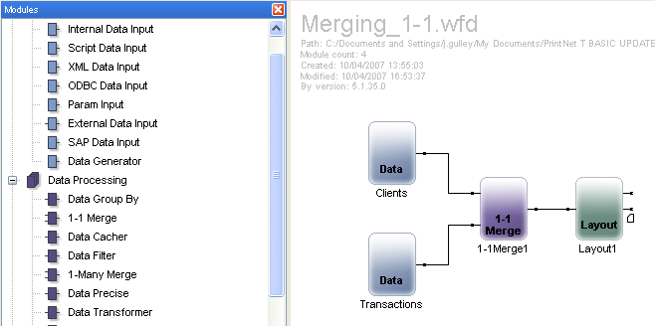
1-1 Merge Module
Add the 1-1 Merge module directly after two Data Inputs in the workflow, and connect the modules.

Slide 10
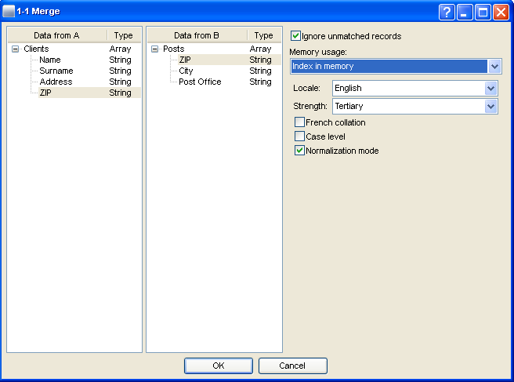
1-1 Merge Module
Double-click on module to open it.
A common variable is needed
Notes:
Note the two data inputs: Clients and Posts. Both of these files contain the variable “ZIP”. This will be the basis for our 1-1 Merge.

Slide 11
1-1 Merge Module
Double-click on module to open it.
Ignore unmatched records
Notes:
If you don’t check “Ignore unmatched records”, then any time there is a missing input in the ZIP variable, or if there is an unmatched record, there will be an error message.

Slide 12
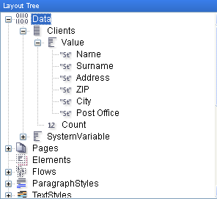
1-1 Merge Module
Notice the new Data structure in Layout.
All variables from both files are available
under a single array.
Variables from first Data Input (Clients)
The common variable in both files
Variables from second Data Input (Posts)

Slide 13

1-1 Merge – Exercise
Merge data files 1-1.
  Open 1-1 Merge.wfd.
  Use Employees.csv, Companies.csv, and Wages.csv as data inputs.
  Insert the 1st1-1 Merge module and link the employees and Customers data fields to the merge module, and use the CompName and EmpComp which share the common relationship.
  Add another 1-1 Merge Module, and connect the output from the first 1-1 Merge Module and the Wages data Input module , and click on the EmpID and use these fields as the Common relationship.
  Connect your final module to Layout and check data proof to verify your data structure.
Notes:
Now all employees have their personal information, company information, and wage appended under one array.

Slide 14
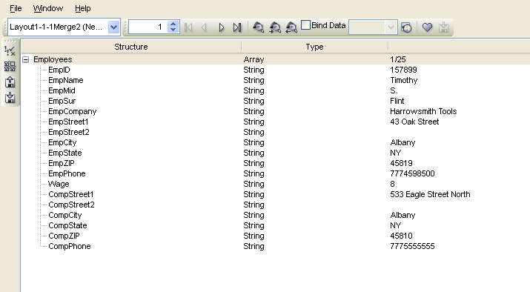
1-1 Merge – Exercise
1-1 Merge resolution.
Still just one array
Wages and Companies appended under first array
Notes:
Now all employees have their personal information, company information, and wage appended under one array.

Slide 15
2. 1-Many Merge

Slide 16
1-Many Merge Module
1-Many Merge:
  Merges two data files that have a one-to-many relationship
  Uses the second data file to create a sub-array within the first data file array (under the common variable)

Slide 17


Data Merging – Example
A credit card company creates monthly bills from two files; one file contains customer information and the other contains customer transactions. Those are merged together based on AccNumber.
Contains: name, address, phone number, and account number of all customers
Customer 1
File 1
CCardClients.csv
Contains: account number and all monthly transaction information for all customers
Customer 2
File 2
ClientsTransactions.csv
PrintNet T
Customer 3
Separate data files created for customer information and customer transactions.
Files merged on AccNumber variable
Customers receive bill with their personal information AND transactions.
Notes:
Notice how each customer’s bill is different in length? Each customer has a unique set of transactional data. Customer 2 obviously hasn’t used his credit card a lot this month, whereas Customer 3 has.

Slide 18
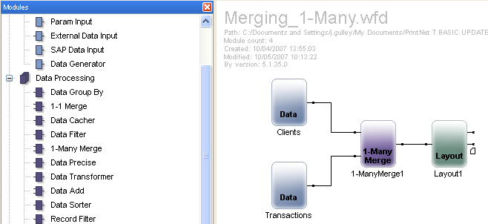
1-Many Merge Module
Add the 1-Many Merge module directly after two Data Inputs in the workflow, and connect the modules.

Slide 19
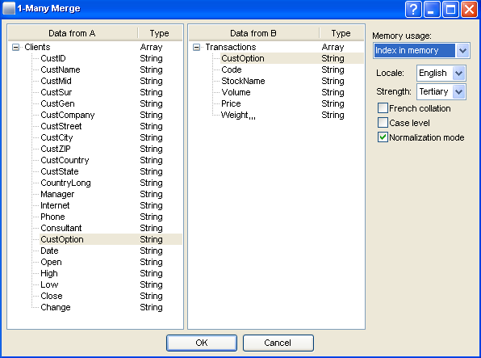
1-Many Merge Module
Double-click on module to open it.
A common variable is needed
Notes:
Note the two data inputs: Clients and Transactions. Both of these files contain the variable “CustOption”. This will be the basis for our 1-Many Merge.

Slide 20
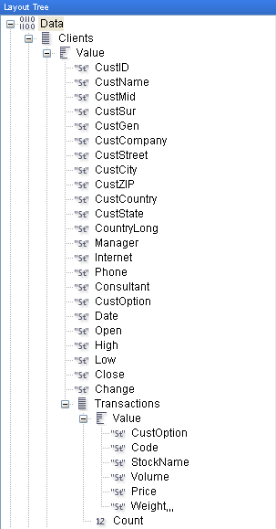
1-Many Merge Module
Notice the new Data structure in Layout.
The variables from the second data file
appear under a second array within the
array of the first data file.
Variables from first Data Input (Clients)
The common variable in both files
Variables from second Data Input (Transactions)

Slide 21
1-Many Merge Module
First data file array (Clients)
Second data file array (Transactions)
Notes:
You can see that the variables from the second data file appear under a second array, which is actually within the array of the first data file.

Slide 22
1-Many Merge – Exercise
Insert a 1-Many Merge module and merge two files.
  Open 1-ManyMerge.wfd.
  Add another Data Input module; use Hours.csv as the input file.
  Just before Layout, add a 1-Many Merge module and merge your new data with the data from the previous 1-1 Merge exercise.
  Attach the 1-Many Merge module to Layout; check your data proof.
Notes:
Now all employees have their personal information, company information, and wage appended under one array, and a second sub-array with all of their worked hours during a work period.

Slide 23
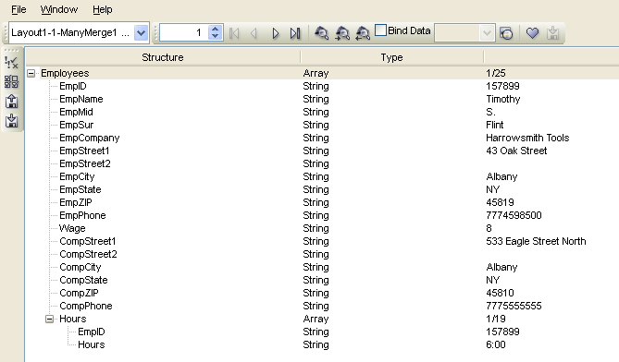
1-Many Merge – Exercise
1-Many Merge resolution.
Sub-array exists within the first array.
Notes:
Now all employees have their personal information, company information, and wage appended under one array, and a second sub-array with all of their worked hours during a work period.

Slide 24
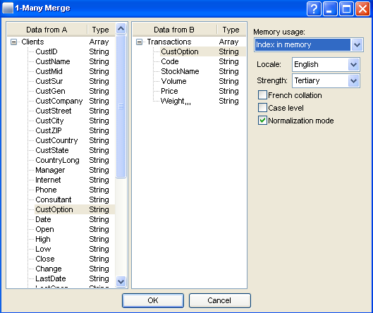
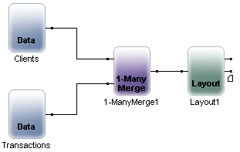
Merging Data – Data File Order
The order your Data Inputs enter a merging module does matter.
The file which enters the top branch will always be the master array.
Clients enters first branch of merge module

Slide 25
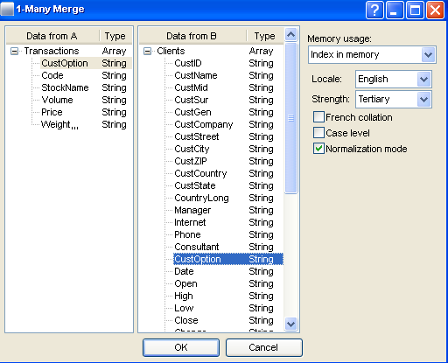
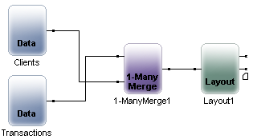
Merging Data – Data File Order
The order your Data Inputs enter a merging module does matter.
The file which enters the top branch will always be the master array.
Transactions enters first branch of merge module

Slide 26

Data Merging – Summary
In this presentation we have learned:
  Why merging data is sometimes needed.
  How to:
    Apply a 1-1 Merge module
    Apply a 1-Many Merge module

Slide 27

Data Merging – Discussion
What two data merging modules in PrintNet T do you know? What does each of them do to data files?
What is needed before you can merge two data files?
Notes:
What two data merging modules in PrintNet T do you know? What does each of them do to data files?
1-1 Merge (appends second data file to the first array); 1-Many Merge (creates sub-array of the second data file inside the first array)
What is needed before you can merge two data files?
You need a common variable.

Slide 28

Thank You.
Do You Have Any Questions?

